Slide 1

Data science for Responsible Leaders
Assignment 2023

Slide 2
Agenda
Introduction of the assignment
Assignment description
Exercise 1
Exercise 2
Exercise 3
Exercise 4
Deadlines
Grading guidelines

Slide 3




Introduction to the assignment
The decision maker of an asset management company has given you the task to invest 1 million euros with a 10-year horizon.
The company learned from former investments that focusing on money only does not lead to the desired return on the long term. The company believes in integrated/Shared Value investments and thinks their investment strategy is best represented by the following four Sustainable Development Goals:
Decent work and economic growth
Reduced inequalities
Responsible consumption and production
Climate Action
The following constraints apply:
Max $550.000 investment in one of the options if focus is on one investment category
Max $1.000.000 in total
Your task is to find the best investment strategy given the available investment opportunities and your company’s priorities.
You are required to follow a fact-based decision-making process such that you can substantiate your (investment) decisions to the management team.
During the upcoming weeks you will therefore apply the seven-step framework of the Responsible Business Simulator (Open Source version).

Slide 4
Together with your group you will write your assignment on the following asset management company:
Group 1 | Group 2 | Group 3 | Asset Management Company
1.1 | 3.1 | 4.1 | Blackrock
1.2 | 3.2 | 4.2 | The Vanguard Group
1.4 | 3.3 | 4.3 | UBS Group
1.5 | 3.4 | 4.4 | BNP Paribas
1.6 | 3.5 | 4.5 | State Street Global Advisors
2.1 | 3.6 | 4.6 | Allianz
2.2 | 3.7 | 4.7 | JPMorgan Chase
2.3 | 3.8 | 4.8 | Goldman Sachs
 | 3.9 | 4.9 | Deutsche Bank
 | 3.10 | 4.10 | Credit Agricole
 | 3.11 | 4.11 | Fidelity
 | 3.12 |  | Aegon N.V.
Group numbers can be found on Canvas

Slide 5

Assignment description 1/2
With your subgroup you will help an asset manager to invest 1 million dollars over a 10-year horizon by following each step of the framework:
Step 1: Describe the strategic challenge and the key stakeholders
Step 2: Define and describe the key outputs that are relevant to the stakeholders
Step 3: Determine internal variable inputs and the decision maker’s options.
Step 4: Draw up scenarios (external variable inputs) and create a plausible bandwidth for all of them.
Step 5: Indicate all dependencies based on the variables in Steps 1-4. Underpin the relations / dependencies with (academic) literature research.
Practice: Insert the information defined in the previous steps into the database such that next steps can be performed in the tool.

Slide 6
Assignment description 2/2
Step 6: Calculate the results for all decision maker’s options and for a new set of priorities. Formulate what strikes you.
Step 7: Recalculate the results for all decision maker’s options for all scenarios. Formulate what strikes you.
Deliverable:
The database on which the calculations are based and;
A report consisting of a detailed description of your findings (for each step) including a recommendation for the decision maker based on Steps 6 and 7.
During the lectures as well as during the final presentation you will share your findings with the group (and ask them for input).

Slide 7
Exercise 1
Deadline: 07-02-2023
In your subgroup you will:
work on Step 1, Step 2 and Step 3 of the assignment;
prepare a presentation.
With your subgroup you will help an asset manager to invest 1 million dollars over a 10-year horizon by following each step of the framework
Step 1: Describe the strategic challenge and the key stakeholders
Step 2: Define and describe the key outputs that are relevant to the stakeholders
Step 3: Determine internal variable inputs and the decision maker’s options.
Step 4: Draw up scenarios (external variable inputs) and create a plausible bandwidth for all of them.
Step 5: Indicate all dependencies based on the variables in Steps 1-4. Underpin the relations / dependencies with (academic) literature research.
Practice 1: Insert the information defined in the previous steps into the database such that next steps can be performed in the tool.
Step 6: Calculate the results for all decision maker’s options and for a new set of priorities. Formulate what strikes you.
Step 7: Recalculate the results for all decision maker’s options for all scenarios. Formulate what strikes you.

Slide 8
Exercise 2
Deadline: 13-02-2023
In your subgroup you will:
work on Step 4 of the assignment;
use the information collected in steps 1 – 4;
link the elements of the steps via their relations and visualize this
With your subgroup you will help an asset manager to invest 1 million dollars over a 10-year horizon by following each step of the framework
Step 1: Describe the strategic challenge and the key stakeholders
Step 2: Define and describe the key outputs that are relevant to the stakeholders
Step 3: Determine internal variable inputs and the decision maker’s options.
Step 4: Draw up scenarios (external variable inputs) and create a plausible bandwidth for all of them.
Step 5: Indicate all dependencies based on the variables in Steps 1-4. Underpin the relations / dependencies with (academic) literature research.
Practice 1: Insert the information defined in the previous steps into the database such that next steps can be performed in the tool.
Step 6: Calculate the results for all decision maker’s options and for a new set of priorities. Formulate what strikes you.
Step 7: Recalculate the results for all decision maker’s options for all scenarios. Formulate what strikes you.

Slide 9
Exercise 3
Deadline: 27-02-2023
In your subgroup you will:
Create a dependency tree: link the elements of the steps via their relations and visualize this;
Perform literature research: find correlations in (scientific) literature to underpin the relations and dependencies of your dependency tree (homework)
Fill in all sheets in the database template; and for third year students: add your dependency tree to the template
Prepare a presentation.
With your subgroup you will help an asset manager to invest 1 million dollars over a 10-year horizon by following each step of the framework
Step 1: Describe the strategic challenge and the key stakeholders
Step 2: Define and describe the key outputs that are relevant to the stakeholders
Step 3: Determine internal variable inputs and the decision maker’s options.
Step 4: Draw up scenarios (external variable inputs) and create a plausible bandwidth for all of them.
Step 5: Indicate all dependencies based on the variables in Steps 1-4. Underpin the relations / dependencies with (academic) literature research.
Practice 1: Insert the information defined in the previous steps into the database such that next steps can be performed in the tool.
Step 6: Calculate the results for all decision maker’s options and for a new set of priorities. Formulate what strikes you.
Step 7: Recalculate the results for all decision maker’s options for all scenarios. Formulate what strikes you.

Slide 10
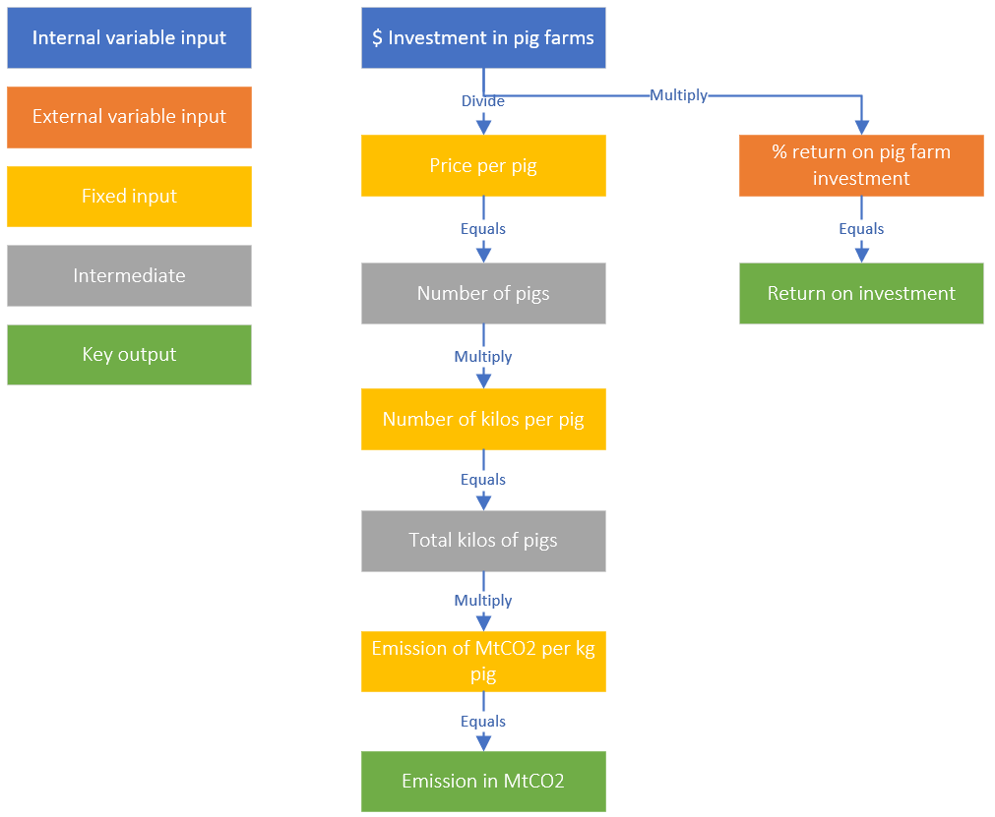
Exercise 3: Create a dependency tree
Example
Create a dependency tree:
link the elements of the steps via their relations and visualize this
Create a dependency tree about the effect of one of your internal variable inputs on one of more of your key outputs
Example

Slide 11
Exercise 3: Perform literature review - Homework
Perform literature research: find correlations in (scientific) literature to underpin the relations and dependencies of your dependency tree
Complete all input data needed to complete your dependency tree via desk research, historical data, expert opinions and/or Monte Carlo simulation
Example

Slide 12
Exercise 3: Database template (1)
Download on Canvas the Excel template called Exercise_3_DRL.xlsx
Sheet Name | Description
Key outputs | Key outputs and their associated themes. You can also adjust their parameters.
Decision makers options | Decision makers options and their associated internal variable values.
Scenario | Scenarios and their associated external variable values.
Fixed inputs | Fixed inputs and their values
Dependencies | Break down formulas in a number of steps resulting in intermediates to make model more transparent
Theme weights | Weights for the themes
Key output weights | Weights for the key outputs
Scenario weights | Weights for the scenarios
Configurations | NOT IN USE

Slide 13
Exercise 3: Database template (2)
From now on you will continue to work with this excel. This excel is based on steps 1-4
Go to the tRBS GitHub repository
Switch to the branch: Nyenrode_DRL.
Fork or clone the repo into your local computer. (Here is how you can clone a repo)
(Download on Canvas the Excel template called Exercise_3_DRL.xlsx or find it under trbs/model/data/EXERCISE_NAME_HERE)
Adjust your Excel document as follows:
Fill in the missing Theme name in the “key_outputs” sheet (this theme name is also missing in one other sheet “theme_weights”, fill that as well!)
The value for the $ amount investments for the Decision Maker Option “Focus on cryptocurrency” is missing in the Excel. Fill in the values for this DMO in the Excel document (“decision_makers_options” sheet) and take into account the constraints mentioned in slide 3.
Load the template in the Jupyter Notebook for your case and run through the notebook.
After you’ve run through the notebook once and obtained your results, prioritize SDG 8 / Economic growth by adjusting the weight for the economic growth theme in the excel template to 5, leave others at 1. Re-run the notebook and note the change in the results in the weighted appreciations.

Slide 14
Exercise 3: Database template (3)
Sketch the relationship between the $ Investment in clean water and the key outputs Income growth for low-income families and the Return on investment.
Adjust the Excel template as follows:
Check if “Investment in clean drinking water” exists in the decision_makers_options sheet.
Add the fixed input for the relation between clean water and income growth with in the fixed_inputs sheet
Add the external input for all the scenarios for the return on investment of clean water in the scenarios sheet.
Build the dependencies that link the investment in drinking water to the key output “Income growth for low income families” and “Return on investment” in the Dependency sheet. (Hint: those should look similar to other return on investment and income growth dependencies)
Only for third year students: add your dependency tree that you created in the first step to the model
Hint 1: Use a Fixed input for the relation between income growth and investment in clean water.
Hint 2: Use a External input for the relation between investment in clean water and return on investment from clean water

Slide 15
Exercise 4
In the last lecture, each group has to present their entire assignment.
In your subgroup you will:
write a report consisting of a detailed description of your findings (for each step) including a recommendation for the decision maker based on the outputs;
adjust the weights in the sheet “scenario_weights”, “theme_weights” or “key_output_weights” (in order to calculate all steps you need to finalize the template);
prepare a presentation
With your subgroup you will help an asset manager to invest 1 million dollars over a 10-year horizon by following each step of the framework
Step 1: Describe the strategic challenge and the key stakeholders
Step 2: Define and describe the key outputs that are relevant to the stakeholders
Step 3: Determine internal variable inputs and the decision maker’s options.
Step 4: Draw up scenarios (external variable inputs) and create a plausible bandwidth for all of them.
Step 5: Indicate all dependencies based on the variables in Steps 1-4. Underpin the relations / dependencies with (academic) literature research.
Practice 1: Insert the information defined in the previous steps into the database such that next steps can be performed in the tool.
Step 6: Calculate the results for all decision maker’s options and for a new set of priorities. Formulate what strikes you.
Step 7: Recalculate the results for all decision maker’s options for all scenarios. Formulate what strikes you.

Slide 16
Deadlines
Deliverables:
Report: - Including the 4 exercises - Excel file
Interim presentations
Final presentation
Deadlines:
Exercise 1 | 07-02-2023
Exercise 2 | 13-02-2023
Exercise 3 | 27-02-2023
Exercise 4 | 03-03-2023
Presentation | 03-03-2023
Final deadline report | 10-03-2023

Slide 17
Grading presentations:
Presentation Evaluation Criteria | Presentation Evaluation Criteria | Weight
1 | The presentation(s) contain a clear line of reasoning and justification of the subject. | 25%
2 | The presentation(s) are of an outstanding academic level and contains new insights/ accurate application of literature research | 20%
3 | The presentation(s) are presented in an attractive and understandable way. | 10%
4 | The presentation(s) reflect that students understand the organization’s challenge | 20%
5 | The presentation(s) display how data and dialogue are used to formulate a strategy for the organization of choice | 25%
Total average grade | Total average grade | 100%

Slide 18
Grading report of the Decision Making Model:
Report Criteria | Report Evaluation Criteria | Weight
1 | The report contains a clear line of reasoning and justification of the subject and is written in a consistent and coherent way. | 25%
2 | The report is of an outstanding academic level and contains new insights / accurate applications of literature research. | 20%
3 | The report covers the seven-step-framework of the RBS, including the explanation and argumentation of decisions taken. | 35%
4 | The Excel template contains all relevant input of the model and can be used to run the model in the tooling. | 20%
Total average grade | Total average grade | 100%

Slide 19

Graveyard

Slide 20
- Test with a DA colleague (new joiner)

Slide 21
Finally, discuss with a course teacher.

Slide 22
Exercise 3: Create a dependency tree
Example
$ Investment in clean drinking water
Price per liter of produced water
% return on clean water investment
Liters of clean drinking water produced
Return on investment
Salary increase per liter of clean water produced
Income growth for low income families
Example

Slide 23
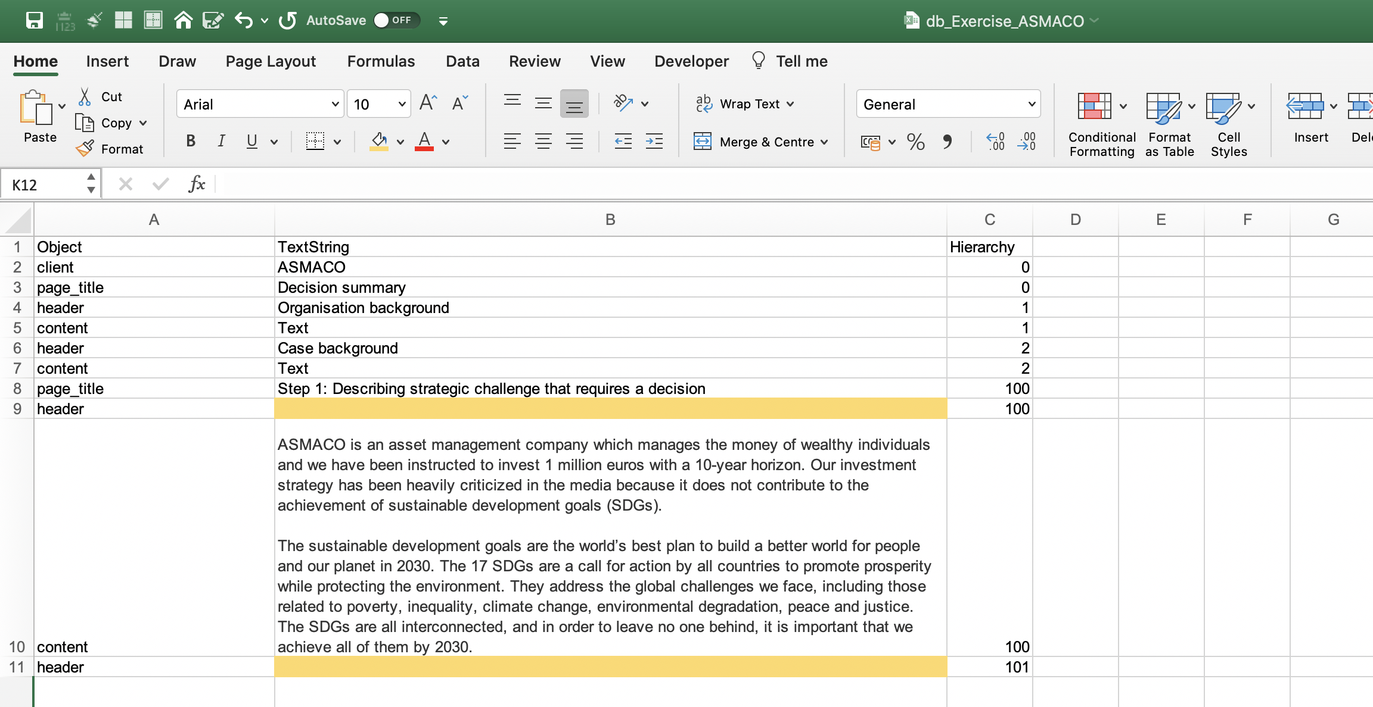
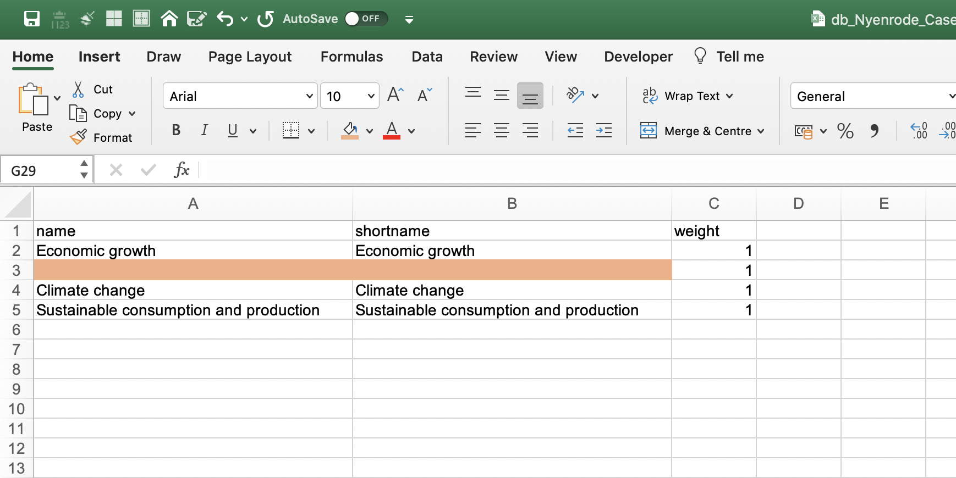
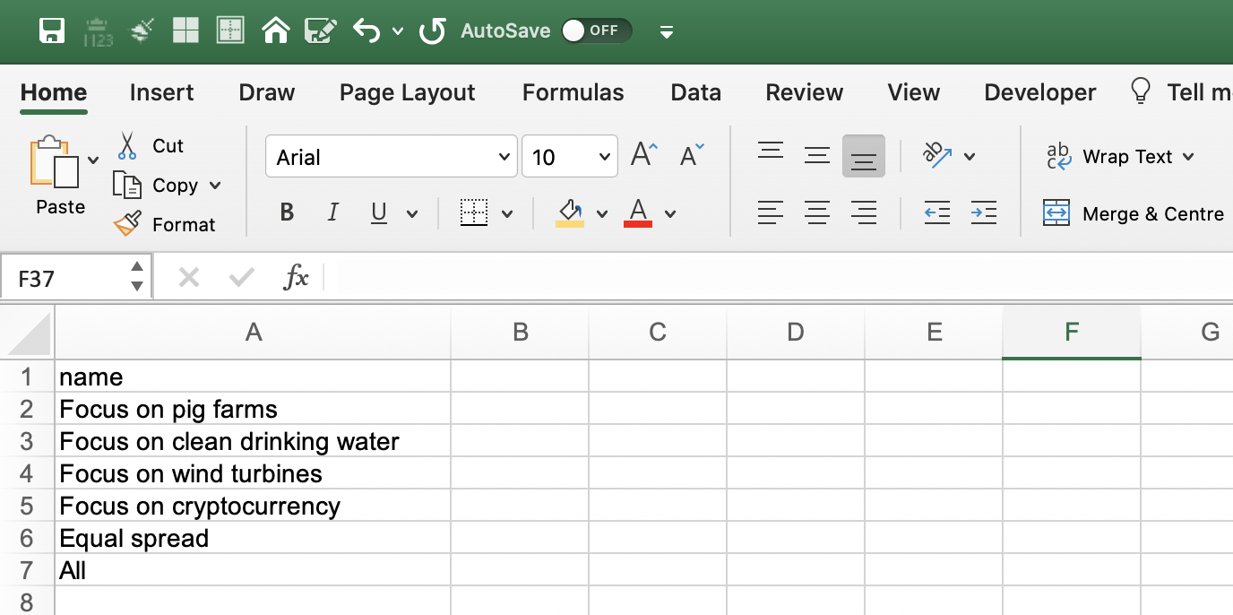
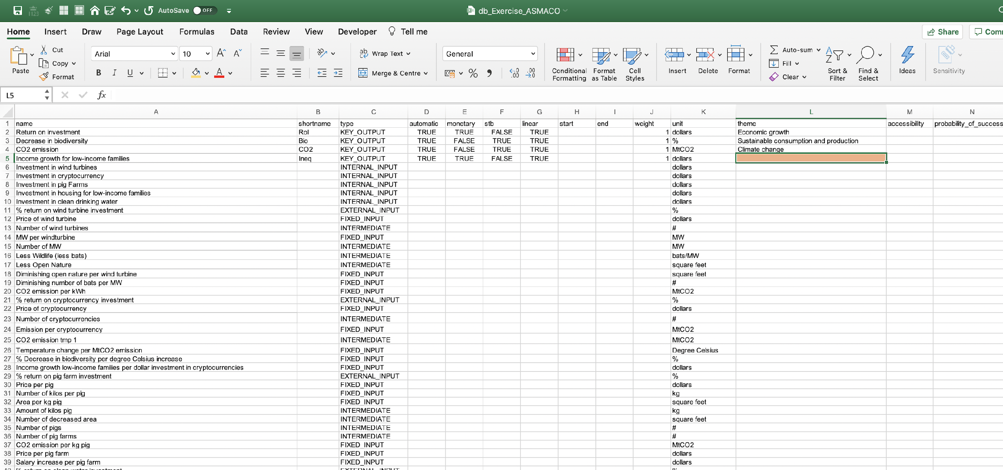
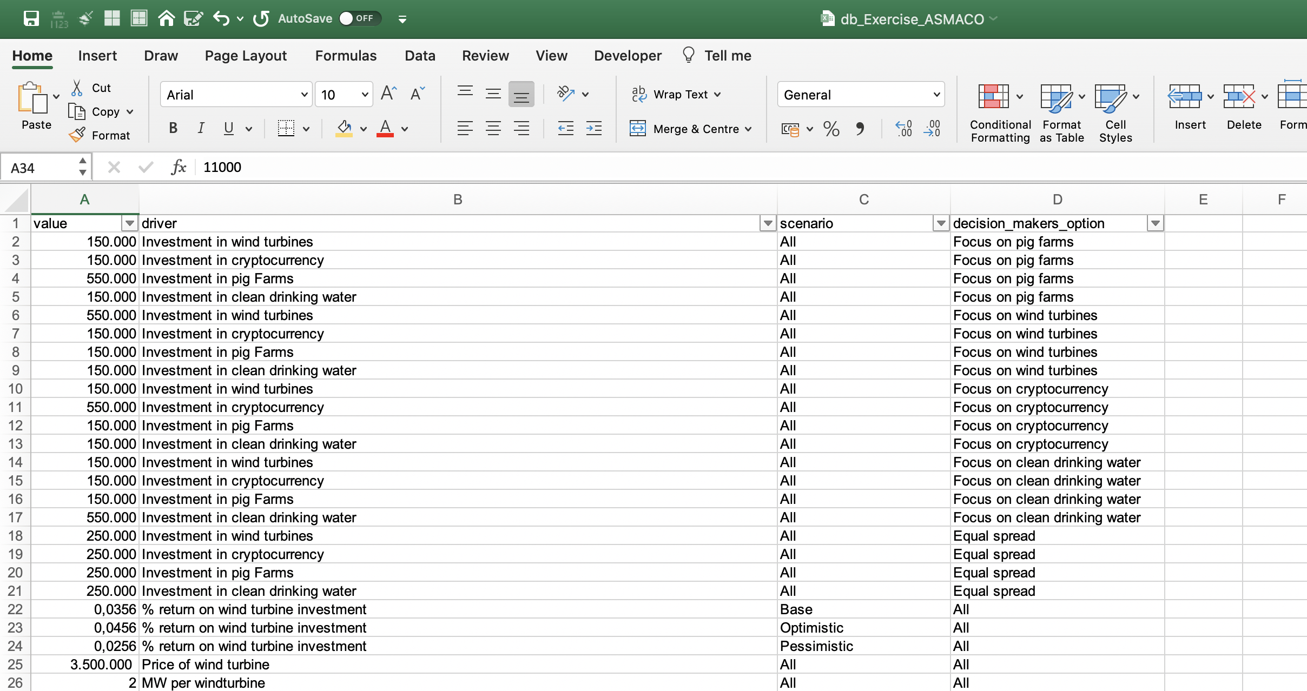
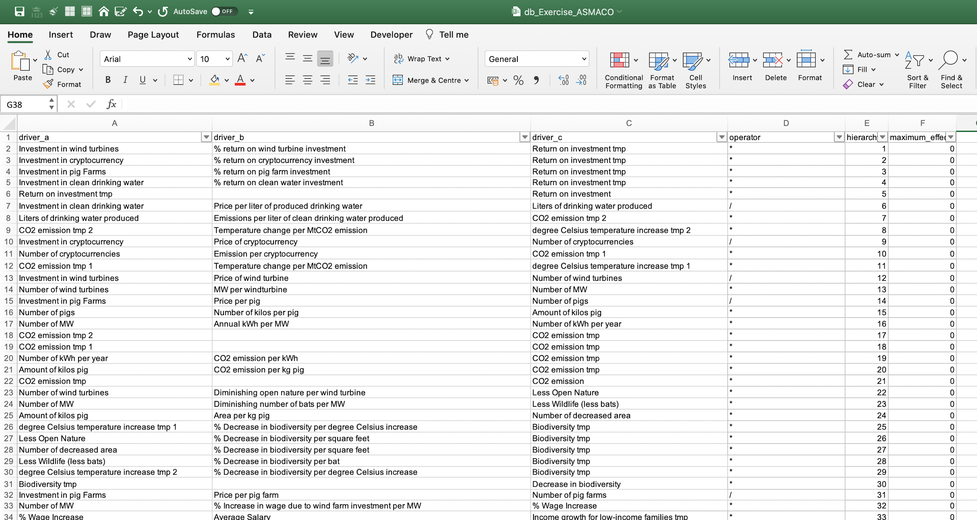
Exercise 3: Database template (1)
Download on Canvas the Excel template called Exercise_3_DRL.xlsx
FrontEndDescription
In this sheet you can adjust all descriptions for the front end of the tool, you can also use this sheet to tailor the tool to the language of the client
Theme
In this sheet you name the themes and give them weights
DecisionMakersOption / Scenario
These two sheets are similar and show the decision maker’s option names and scenario names
Driver
The driver sheet is rather complex and contains the names of all variables.
For key output values more columns should be filled than for the other variable types
DriverValue
For each driver that is used in the calculations there should be values for the decision maker’s options and scenarios
Dependency
Break down formulas in a number of steps resulting in intermediates to make model more transparent

